Slide 1


Mobile Phone Security
Dr. Digvijaysinh Rathod
Associate Professor
(Cyber Security and Digital Forensics)
Institute of Forensic Science
Gujarat Forensic Sciences University
digvijay.rathod@gfsu.edu.in

Slide 2
Android boot process
Dr. Digvijaysinh Rathod

Slide 3


Reference
digvijay.rathod@gfsu.edu.in

Slide 4
Android boot process
When an Android device is first powered on, there is a sequence of steps that are executed, helping the device to load necessary firmware, OS, application data, and so on into memory. The sequence of steps are:
1. Boot ROM code execution
2. The boot loader
3. The Linux kernel
4. The init process
5. Zygote and Dalvik
6. The system server
Dr. Digvijaysinh Rathod

Slide 5
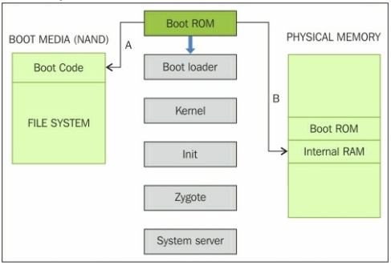
Android boot process
Dr. Digvijaysinh Rathod

Slide 6
Android boot process
initializes
device hardware
Android Power On
Starts
Boot ROM
A
Boot ROM scan till it detect and finds boot media
Boot Code
File System
boot loader
B
Established
Copied
boot sequence
Physical Memory
Boot ROM
Internal RAM
External RAM
execution shifts to the code loaded into the RAM.
Dr. Digvijaysinh Rathod

Slide 7
Android boot process – Boot Loader
The boot loader is a piece of program that is executed before the operating system starts to function.
there are two stages—
initial program load (IPL)
second program load (SPL).
Dr. Digvijaysinh Rathod

Slide 8
Android boot process – Boot Loader
Detecting and set up
Physical Memory
Boot ROM
Internal RAM
External RAM
IPL
Copied
SPL
Execution is transferred
SPL is copied in to RAM
Android OS
Load Kernel
Load
boot modes such as fastboot, recovery etc.,
Provide access
Boot media
Boot Code
File System
Linux Kernel
look for
Dr. Digvijaysinh Rathod

Slide 9
Android boot process – Linux Kernal
The Linux kernel is the heart of the Android operating system and is responsible for process management, memory management, and enforcing security on the device.
After the kernel is loaded, it mounts the root file system (rootfs) and provides access to system and user data.
When the memory management units and caches have been initialized, the system can use virtual memory and launch user space processes.
The kernel will look in the rootfs for the init process and launch it as the initial user space process.
Dr. Digvijaysinh Rathod

Slide 10
Android boot process – The init process
The init is the very first process that starts and is the root process of all other processes - (init.rc).
The init process will parse the init.rc script and launch the system service processes.
At this stage, you will see the Android logo on the device screen.
Dr. Digvijaysinh Rathod

Slide 11
Android boot process – Zygote and Dalvik
Zygote is one of the first init processes created after the device boots.
It initializes the DVM & tries to create multiple instances to support each android process.
Zygote facilitates using a shared code across the VM, thus helping to save the memory and reduce the burden on the system.
All the core features of the device such as telephony, network, and other important functions, are started by the system server
Dr. Digvijaysinh Rathod
Notes:
Fork new processes

Slide 12
Android boot process – System server
The following core services are started in this process:
Start Power Manager
Create Activity Manager
Start Telephony Registry
Start Package Manager
Set Activity Manager Service as System Process
Start Context Manager etc.,
Dr. Digvijaysinh Rathod

